Slide 1
Flipping the Classroom
Brandy Goodwin
Martha Roelofs
Shannon TerMeer

Slide 2
Introduction
What is Flipping the Classroom?
Before Flipping
Discovery and Research
Implementation
Improvements

Slide 3

2010-2011 School Year
Algebra 1A
First third of high school
Algebra 1 curriculum
Spent 3-4 days per section
  Day 1: Teach section and assign homework
  Day 2/3: Review homework, answer questions and assign second homework
  Day 3/4: Review homework and give
  homework quiz (HWQ) with notes

Slide 4
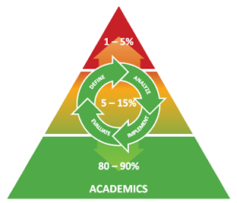
2010-2011 School Year
Response to Intervention (RTI)
& Math Lab
Before or after school
Students could move
forward before completed
Remediation
Retake HWQs (w/ notes)

Slide 5
2010-2011 School Year
Testing
Quizzes every 3 sections
  Without notes
  No retakes
Chapter Tests (3)
  Without notes
  No retakes
High School Placement Exam
60% of students skipped Algebra 1A in 2010-2011
vs.
0% of students in 2009-2010

Slide 6
Discovery and Research
TechSmith Article (Hooray for Social Media!)
Videos
  Flipped Classrooms and the Mastery
  Approach to Learning
  Jon Bergman
  Flipped Classrooms and Video as Homework
  Aaron Sams
Visited Hamilton to see flipping in person

Slide 7
Reasons to Flip
Mastery Learning: Immediate RTI
2012 Evaluation Goal: 70% of students 70% or higher on each Chapter Test
Parents: Inability to help with homework
Homework: Student frustration, “completing” homework
Pace: Talented students held back while others struggled
Student Focus: Shifts to learning rather than grades

Slide 8
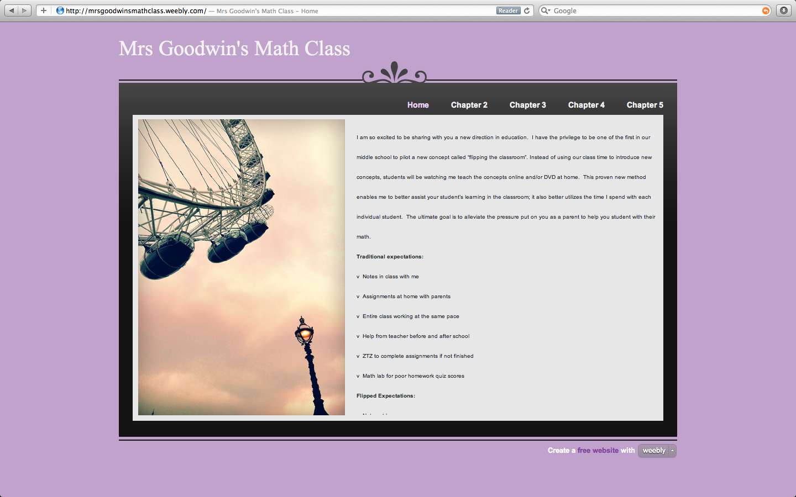
First Steps
1. Build Website

Slide 9
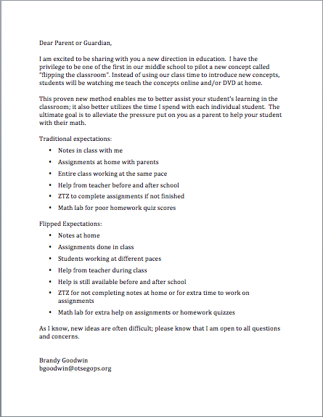
First Steps
2. Parent letter

Slide 10
First Steps
3. Record Videos for Notes
Camtasiahttp://mrsgoodwinsmathclass.weebly.com/section-2-6.html
Screen Chomp http://mrsgoodwinsmathclass.weebly.com/section-4-1.html

Slide 11
First Steps
4. Create Student
Checklist

Slide 12
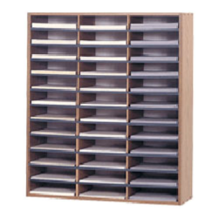
First Steps
5. Organize workspaces
  Homework grading area
  Test taking area
  Student work area
  Teacher Testing Materials

Slide 13






The Flipped Classroom
Homework
In class

Slide 14
Flipping in Otsego
Flipping a Classroom - In our year-long series on Technology in the Classroom, part II takes a look at a new concept called “Flipping.” Even parents might be excited about this switch.
Otsego Public Schools http://www.otsegops.org/news/flipping
Cool at School: Flipping the rules of school
Channel 3 News http://wwmt.com/shared/newsroom/top-stories/stories/wwmt_vid_1561.shtml

Slide 15
Needed Improvements
Paperwork
Lab experiences
Minimum requirements
CCSS

Slide 16
Links
At Virginia Tech, computers help solve a math class problem
The Washington Post http://www.washingtonpost.com/local/education/at-virginia-tech-computers-help-solve-a-math-class-problem/2012/04/22/gIQAmAOmaT_story.html?hpid=z5
Khan Academy: The future of education?
CBS 60 Minutes http://www.cbsnews.com/8301-18560_162-57394905/khan-academy-the-future-of-education/?tag=contentMain;contentBody

Slide 17
Links
8th Grade Website
http://mrsgoodwinsmathclass.weebly.com
High School Website
http://ohsbulldogmath.weebly.com/index.html

Slide 18
Links
Flipping Webinar http://novemberlearning.com/webinar-with-alan-november-and-dr-eric-mazur/
Flipping Social Media http://vodcasting.ning.com/
Ramsey Musallam on Flipping http://flipteaching.com/

Slide 19
Questions?
Brandy Goodwin bgoodwin@otsegops.org
Martha Roelofs mroelofs@otsegops.org
Shannon TerMeer stermeer@otsegops.org

